Slide 1
Project EDA SQL
Car Sales dataset

Slide 2
Dataset Introduction
Available details are the following :
Year
Brand
Model
Trim
Category
Transmission Type
Vin (Vehicle Identification Number)
State Of Registration
Condition Rating 1 To 49
Odometer Reading 1 To 999’999
Exterior Colour
Interior Colour
Seller Name
Manheim Market Report (Mmr) Value
Selling Price
Sale Date
This dataset provides a comprehensive collection of information pertaining to the sale transactions of various vehicles, new and used from end of 2014 to 2015.
Vehicles included in the data are from 1990 to 2015.

Slide 3
Problem Introduction
Our brand new company is looking to enter the car selling market and knows nothing about it.
Scope of analysis : General.
The goal of our analysis is to gain insight on broad data to determine what sub niche of the car market our company should focus on.
We want to know : How big is the market, who is the biggest player, nº of cars sold per month, most sold category, automatic vs manual…

Slide 4
Data Cleaning
Deleted the column MMR as it is not relevant for our analysis.
Deleted the trim column as it is not relevant since we are conducting a general analysis on the cars market.
Cleaned the sale date column to obtain only the day, month and year in SQL preferred format.
Eliminated every row where at least one column has a null value, that way we are working with a dataset without null values :) .

Slide 5
Business Questions with SQL Query
Intro Question Total sales in 2015 across all sellers
0 Show amount of cars sold per month
1 Which car brand sold the most vehicles in 2015
2 Which vehicle model is the most sold overall models across all brands
3 What category of vehicle is the most sold
4 What percentage of the sales do all types of vehicle encompass
5 Most popular colour for toyota cars
6 How many manuals and how many automatics are in the database sorted by each year of production (not sold)?
7 Average odometer of a Nissan Altima when sold
8 Most popular interior for volvos?
9 Which seller has the highest total sales in $ ?
10 Rank sellers by the amount of cars they sold in total descending

Slide 6
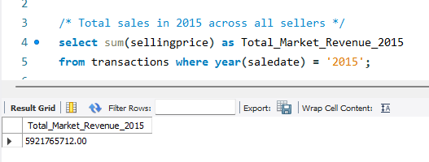
SQL Queries
Intro Question Total sales in 2015 across all sellers
5’921’765’721$ - Almost 6B

Slide 7
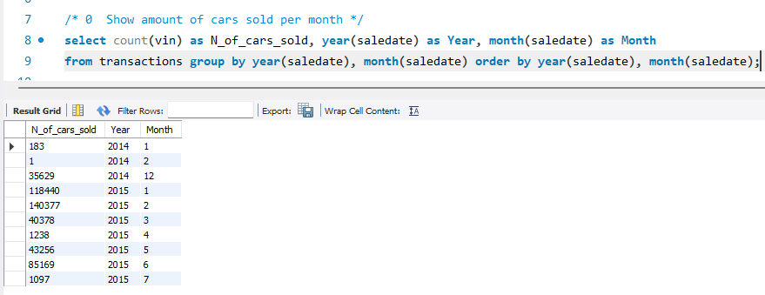
SQL Queries
0 Show amount of cars sold per month

Slide 8
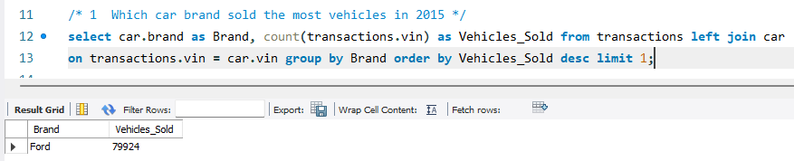
SQL Queries
1 Which car brand sold the most vehicles in 2015

Slide 9
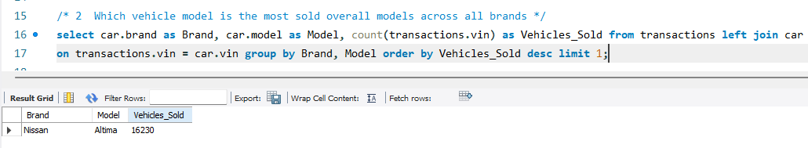
SQL Queries
2 Which vehicle model is the most sold overall models across all brands

Slide 10
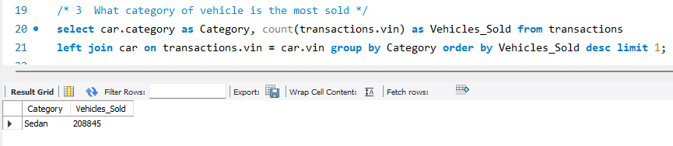
SQL Queries
3 What category of vehicle is the most sold

Slide 11
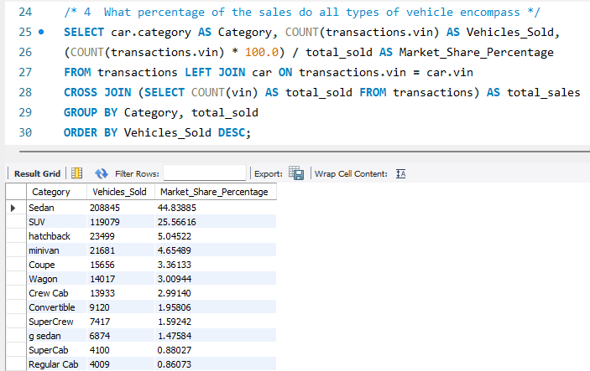
SQL Queries
4 What percentage of the sales do all types of vehicle encompass

Slide 12
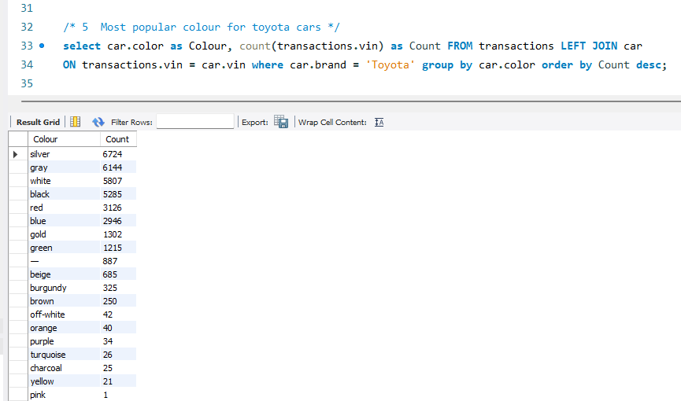
SQL Queries
5 Most popular colour for toyota cars

Slide 13
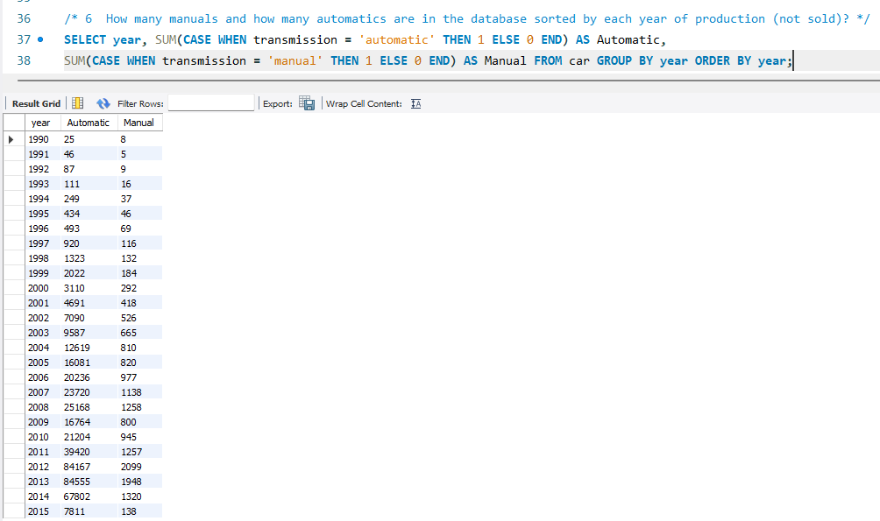
SQL Queries
6 How many manuals and how many automatics are in the database sorted by each year of production (not sold)?

Slide 14
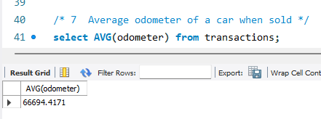
SQL Queries
7 Average odometer of a car when sold

Slide 15
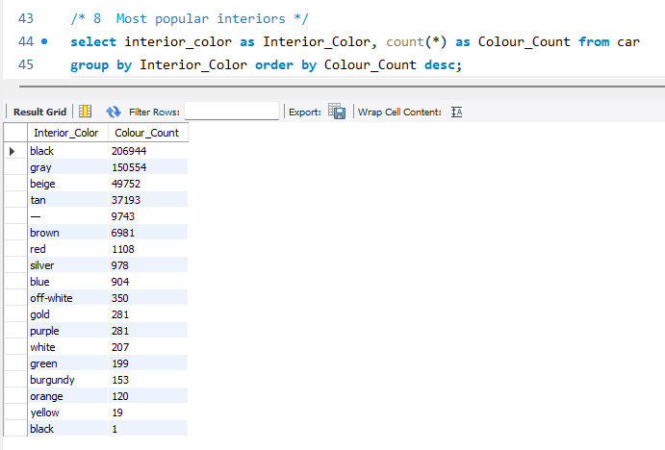
SQL Queries
8 Most popular interiors ?

Slide 16
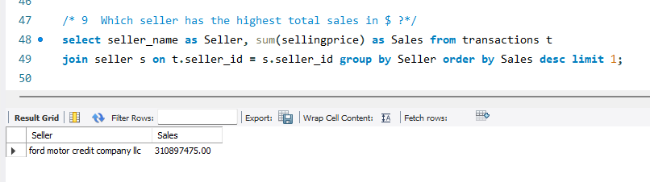
SQL Queries
9 Which seller has the highest total sales in $ ?
310’897’475$ - 310M - Ford Motor Credit Company

Slide 17
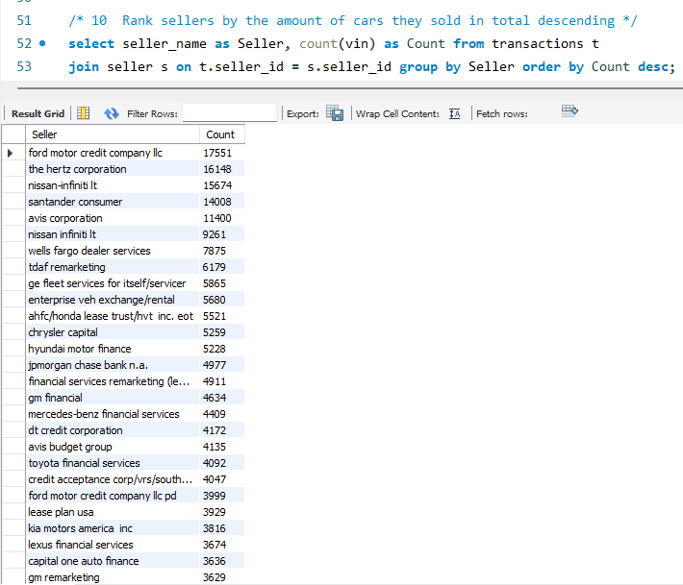
SQL Queries
10 Rank sellers by the amount of cars they sold in total descending

